Slide 1
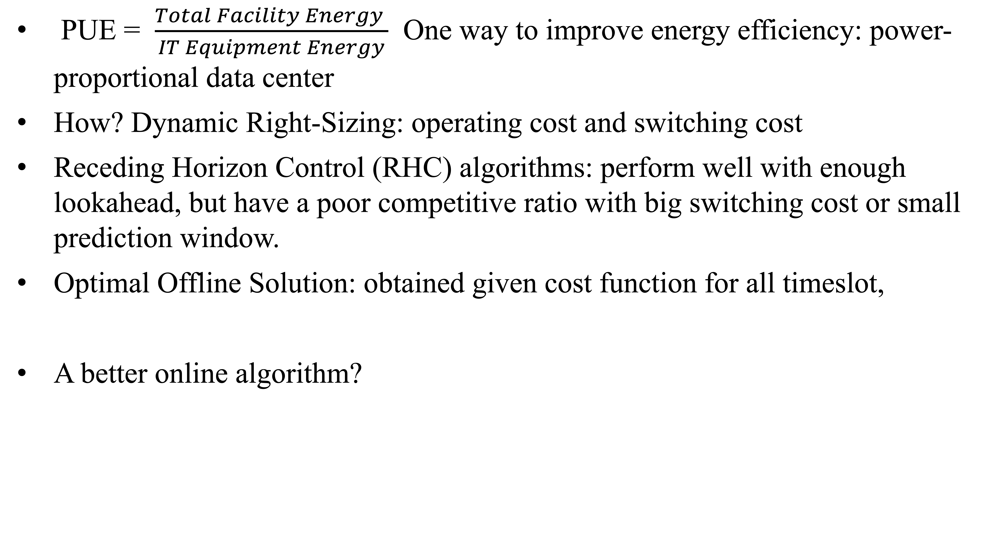
Summary
PUE = $\frac{Total Facility Energy }{IT Equipment Energy}$ One way to improve energy efficiency: power-proportional data center
How? Dynamic Right-Sizing: operating cost and switching cost
Receding Horizon Control (RHC) algorithms: perform well with enough lookahead, but have a poor competitive ratio with big switching cost or small prediction window.
Optimal Offline Solution: obtained given cost function for all timeslot,
A better online algorithm?
define the lower bounds $x_{τ}^{L}$ and upper bounds $x_{τ}^{U}$ of $x_{τ}^{∗}$
Notes:
Here is the summary of our presentation. What is energy efficiency? It is to utilize less energy when performing tasks and eliminating energy waste. Power Use Effectiveness (PUE) is used to measure the energy efficiency of data centers.
PUE is the ratio of the amount of energy used in the center by the energy delivered to computing equipment.
One way help improving the energy efficiency, is to Design data center that are power-proportional. An Existing approach is to dynamically “right-size” the data center.
Dynamic right-sizing is when distributing the requests to servers during the periods of low load occur, the low load here means when the server is not needed, or it has no jobs assigned. IT will then change to a power-saving mode by turning off or going to sleep.
Major coasts of right-sizing: operating cost and switching cost.
Of course there are several challenges for implementing dynamic right-sizing.
First, let‘s consider the standard online algorithm to the cost optimization problem. It is called Receding Horizon Control (RHC) algorithms. It perform well with enough lookahead, but have a poor competitive ratio with big switching cost or small prediction window.
In order to exploit the structure of the online solution, the first task is to characterize the optimal offline solution, the optimal solution is obtained given cost function for all timeslot.
It define upper bond and lower bond. For the lower bound, switching cost is incurred for each server comes out of power-saving mode, for the upper bound, switching cost is incurred for each server toggled into power-saving mode.
Now we talk about the algorithm discussed in this paper.

Slide 2
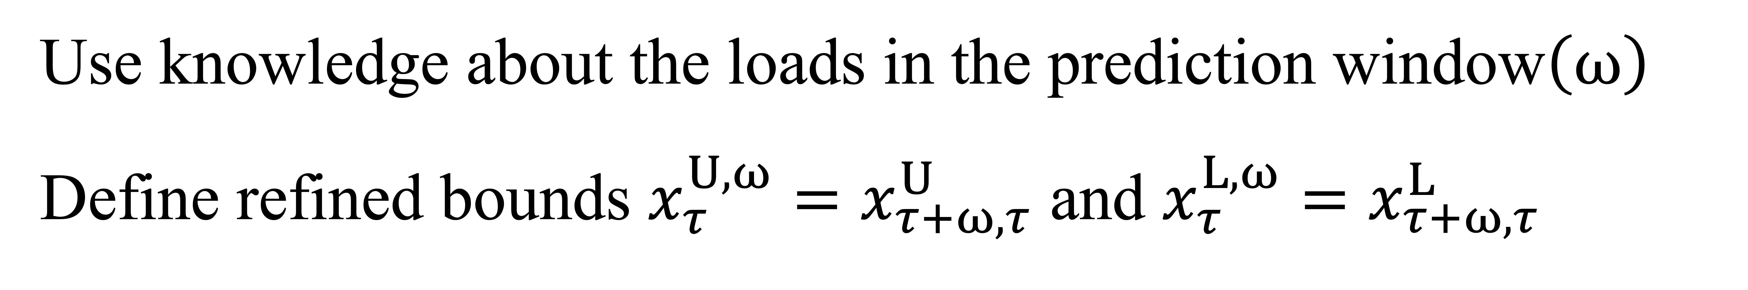
This paper presents: Lazy Capacity Provisioning, LCP(𝜔)
Experiment: From Hotmail and six RAID volumes at MSR Cambridge
Results:
Guarantees cost no larger than 3 times the optimal cost, under very general settings;
Simple to implement in practice and provides much more stable cost saving with general settings
Use knowledge about the loads in the prediction window$\left(ω\right)$
Define refined bounds $x_{τ}^{U,ω}=x_{τ+ω,τ}^{U}$ and $x_{τ}^{L,ω}=x_{τ+ω,τ}^{L}$
Notes:
The design of LCP is motivated by the structure of the optimal offline solution.
LCP uses future information in a prediction size of $ω$ and we define the upper bound and lower bound, note that $ω$is allowed to be 0. It means no information except current timeslot.
The workloads for these experiments are drawn from I/O traces of two real-world data centers: Hotmail and six RAID volumes at MSR Cambridge
From the results ,we can draw that LCP Guarantees cost no larger than 3 times the optimal cost, under very general settings and is Simple to implement in practice and provides much more stable cost saving with general settings.

